Slide 1
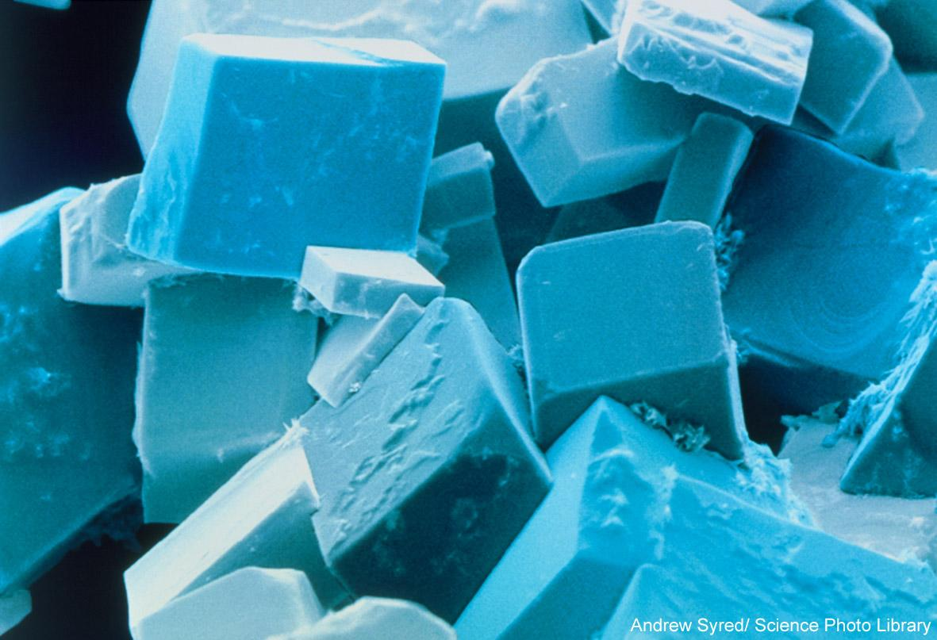
Ionic Structures
Unit 2
Lesson 4

Slide 2
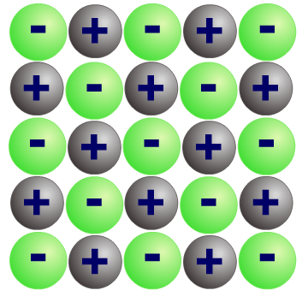
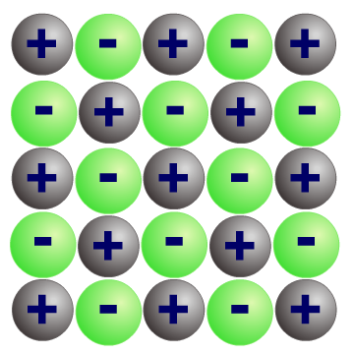
Recap: ionic bonding
Compounds that contain ions are called ionic compounds.
These compounds are usually formed by a reaction between a metal and a non-metal.
Electrons are transferred from each metal atom to each non-metal atom. The metal and the non-metal atoms form ions with full outer shells.
The positive and negative ions are strongly attracted to each other. This strong electrostatic force of attraction is called ionic bonding.

Slide 3
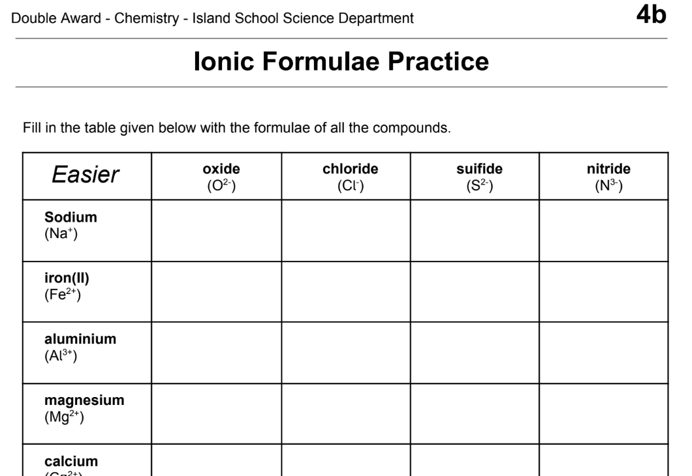
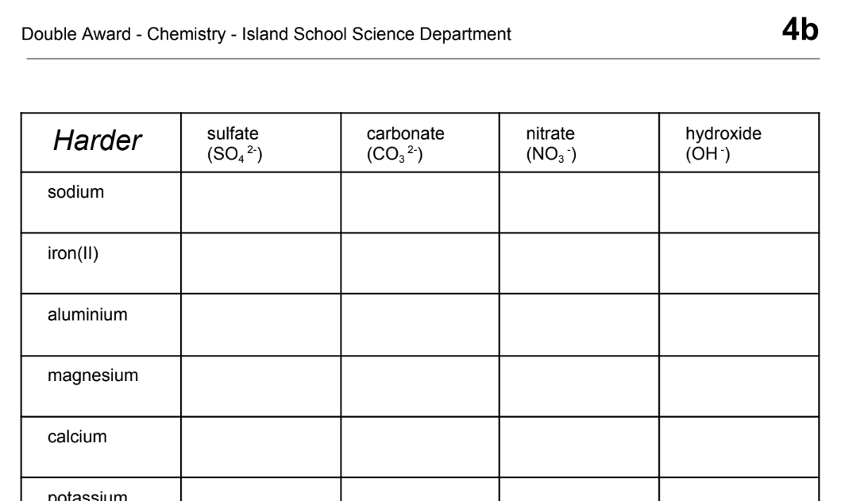
Recap: writing ionic formula
What are the formulae of the ionic compounds from different combinations of cations and anions?
Page 23
Page 24

Slide 4
Today’s Aim
Unit 2
Lesson 4
By the end of this lesson I will be able to describe the properties of ionic compounds

Slide 5
Turn to blank page 27
During the next few slides, you should take some notes on page 27 of your booklet.
In Y12, you will be doing the IB Diploma or Career path. Either way, you will be expected to take notes while the teacher is explaining challenging concepts.
Try to practice taking notes now about ionic compounds.

Slide 6
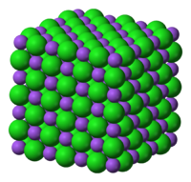
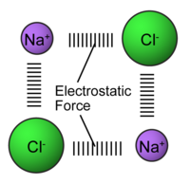
Ionic Compounds
Positive sodium ion Na⁺
Negative chloride ion Cl⁻
The + ions and – ions STRONGLY ATTRACT each other to make a regular crystal structure

Slide 7
Why do ionic compounds form crystals?
Ionic compounds form lattices and crystals when solid
Notes:
The image is a coloured scanning electron micrograph (SEM) of common salt, sodium chloride, recrystallised from distilled water. The salt crystal is built up from a cubic lattice of sodium and chloride ions. In the absence of impurities the exact cubic crystal form is produced. This micrograph shows that in practice this basic cube is usually disrupted by dislocations; these give rise to crystals with a variety of shapes, although they all retain the basic cubic symmetry. Magnification: x280 at 5x7cm size. x975 at 10x8‘.

Slide 8
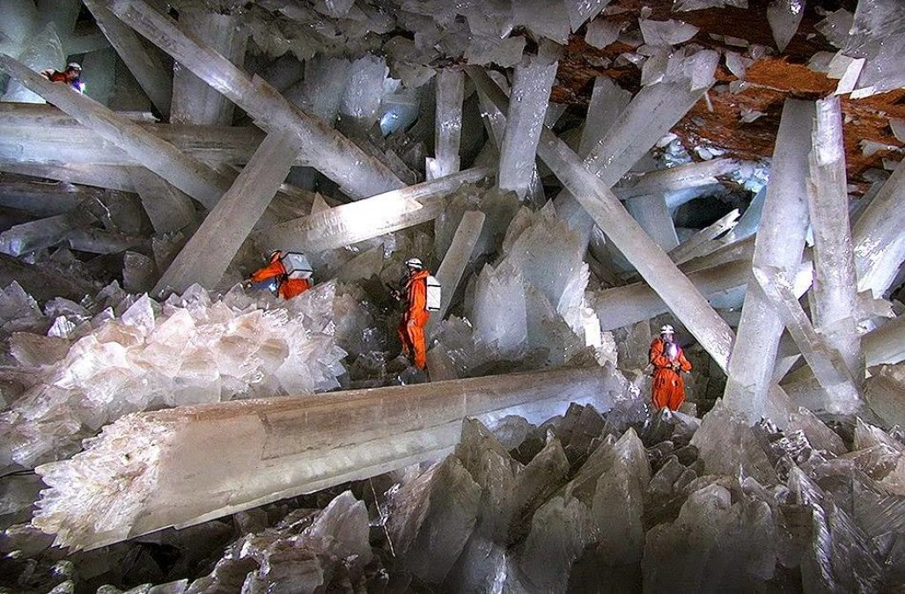
Sometimes these crystals can be massive!
Notes:
The Cueva de los cristales is a cave at a depth of 300 metres near Naica in Mexico.The main chamber contains giant selenite crystals (CaSO₄•2H₂O), some of the largest natural crystals ever found. The cave's largest crystal found to date is 12 m in length, 4 m in diameter and 55 tons in weight. When it was accessible, the cave was extremely hot, with air temperatures reaching up to 58 °C with 90 to 99 percent humidity. The cave is relatively unexplored because of these factors. Without proper protection, people can only endure approximately ten minutes of exposure at a time.

Slide 9
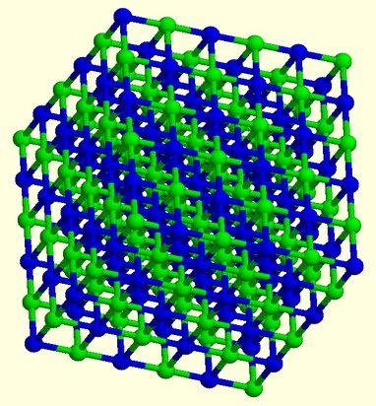
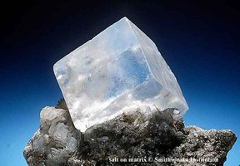
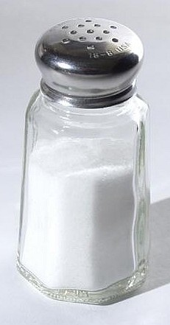
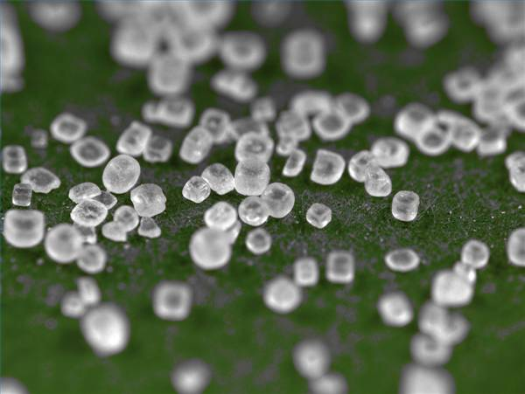
Ionic compounds have high melting and boiling points
Strong ionic bond
Sodium chloride melts at over 800°C

Slide 10

Ionic Compounds
The strong electrostatic attraction between oppositely charged ions hold everything tightly together.
Because the 3D lattice structure is strong a lot of energy is needed to break these strong ionic bonds.
This means that ionic compounds have high melting and boiling points.

Slide 11
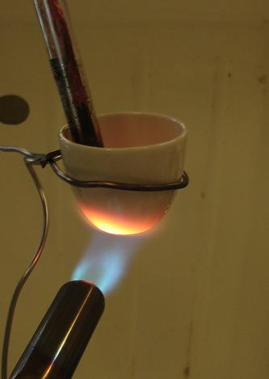
What’s the pattern here?
Ionic compound | Melting point (°C)
potassium chloride | 770
sodium chloride | 801
copper oxide | 1446
calcium oxide | 2707

Slide 12
Heating ionic compounds
High melting and boiling points
Compound | Charge on the ions | Melting point (ºC) | Boiling point (ºC)
sodium chloride
1+ and 1-
801
1413
magnesium oxide
2+ and 2-
2852
3600
strong ionic bonds hold ions together
Ionic bonds are strong and a lot of heat energy is needed to break them.
Larger differences in ionic charges produce stronger ionic bonds and so much more heat is required to overcome the forces in magnesium oxide than in sodium chloride.

Slide 13
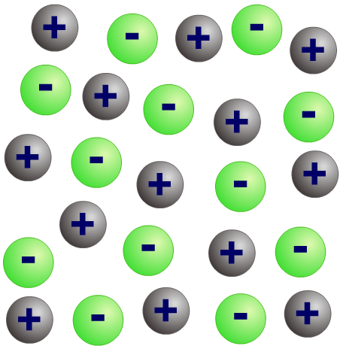
Conduction of electricity
As solids, ionic compounds cannot conduct electricity because their ions are bonded together in the lattice.
ions in solid state cannot move
When liquid (molten), the ions can break free of the lattice and are able to move. The ions are charged particles and so can carry an electric current.
ions in
molten state can move
and conduct electricity
Ionic compounds are usually soluble in water because water molecules have a slight electrical charge and so can attract the ions away from the lattice. When dissolved, the ions are free to move and can carry an electric current.

Slide 14
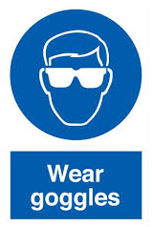
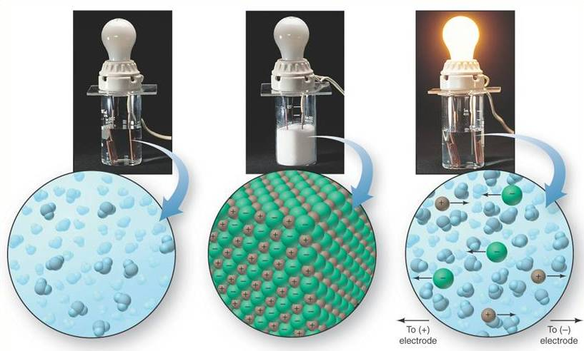
Demonstration
PURE WATER
SOLID SALT
SALT SOLUTION

Slide 15
Ionic compounds can conduct electricity when molten
+
MOLTEN IONIC COMPOUND
+
-
-
-
+
+
-
-
+
-
+
-
+
+
MOLTEN ionic compounds CONDUCT ELECTRICITY

Slide 16
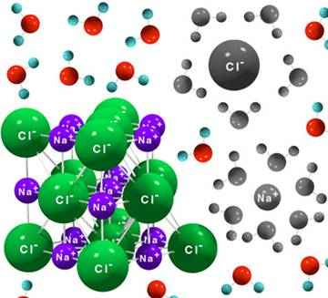
Ionic compounds can conduct electricity when dissolved
water molecule
ions free to move around

Slide 17
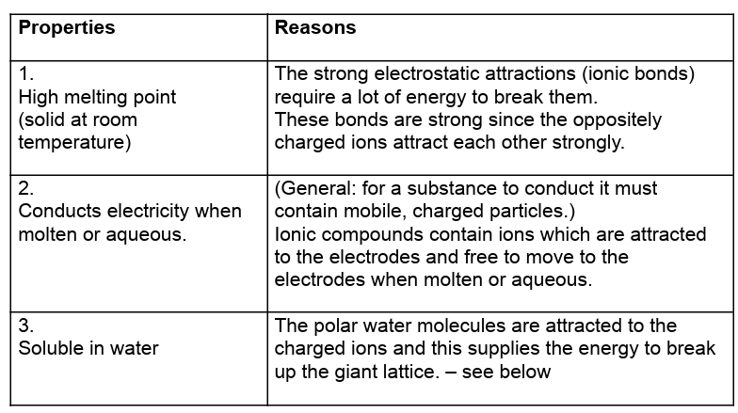
Summary - page 25
Some are, some are not. See solubility rules in a future topic.

Slide 18
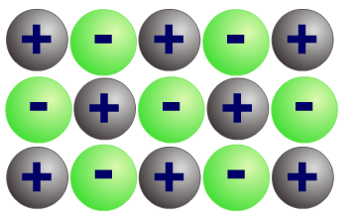
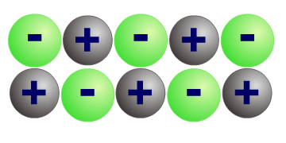
Ionic compound are brittle
Ionic compounds are brittle – they shatter when they are hit. But ionic bonds are strong, so why does this happen?
force
repulsion
When the lattice is hit, a layer of ions is shifted so that ions with the same charges are lined up together.
These like charges repel each other and so split the ionic lattice causing it to shatter.

Slide 19
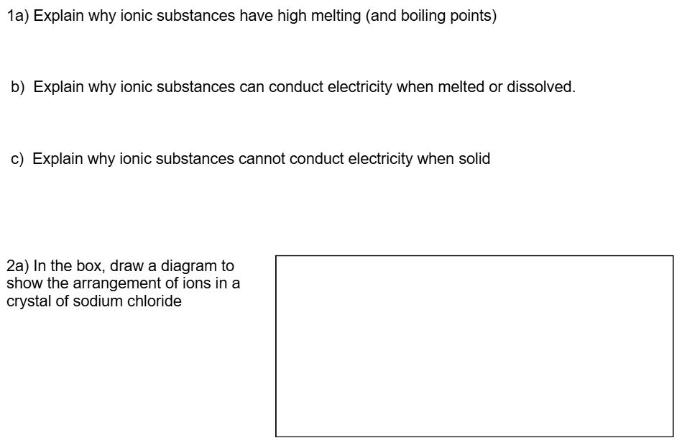
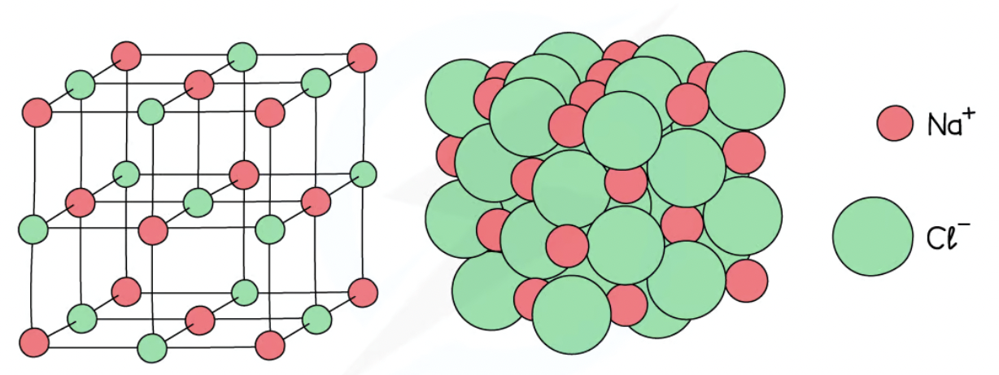
Do all questions on page 26
There is strong electrostatic attraction between oppositely charged ions. A lot of energy is needed to break the ionic bonds.
The ions are free to flow/move and carry charge.
The ions are in a fixed position and therefore cannot move

Slide 20
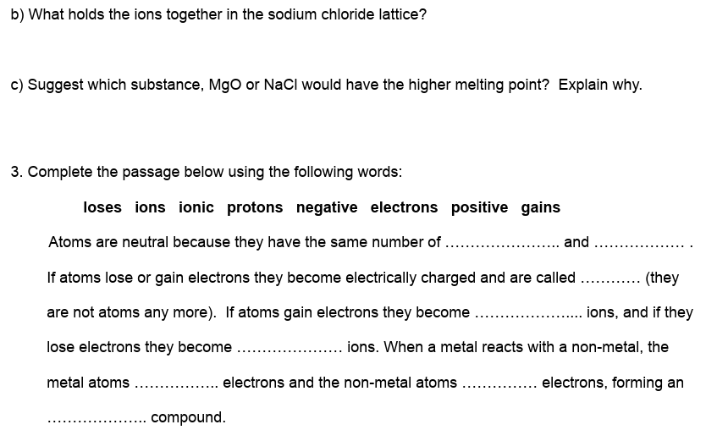
Do all questions on page 26
Strong electrostatic attraction between oppositely charged ions (ionic bonds)
MgO has a higher melting point than NaCl. This is because the charges on the Mg²⁺ and O²⁻ ions are higher (than the Na⁺ and Cl⁻ ions) and so the forces are stronger.
protons electrons
ions
negative
positive
lose
gain
ionic

Slide 21
Ionic Structures
Why are ionic compounds electrically neutral, even though they contain positive and negative ions?
The total number of positive cations equals the total number of negative anions within any given ionic structure.

Slide 22
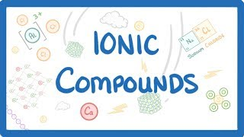
Plenary: video about ionic compounds

Slide 23

What you need to know
Unit 2
Lesson 4
Syllabus Content
1.42
understand why compounds with giant ionic lattices have high melting and boiling points
1.43
know that ionic compounds do not conduct electricity when solid, but do conduct electricity when molten and in aqueous solution.
My Learning

